Slide 1
PERSON MANAGER
A simple Flutter app to demonstrate CRUD operations using SQLite.
https://youtu.be/-QcufX-9E2A

Slide 2
COntents
Introduction
What is Flutter?
What is CRUD?
What is SQLite?
Software Requirements
App Screenshots
App Demo Video
App Source Code

Slide 3
INTRODUCTION
Person Manager is a Flutter-based application for efficient management of person information.
It utilizes SQLite for seamless data storage and retrieval of the person information.
The following person data are included in the application,
First name
Last name
Gender
Date of birth
Profile photo
It implements CRUD (Create, Read, Update, Delete) operations on the person details.

Slide 4

What is FLutter?
Cross-platform UI framework for building apps.
Single codebase for iOS and Android.
Uses Dart programming language.

Slide 5
What is CRUD?
C – Create
R – Read
U – Update
D - Delete
The acronym CRUD stands for Create, Read, Update, and Delete. These are the four fundamental functions of persistent storage.
Create: Creating new records or entities in a database. Read: Retrieving or reading existing records or entities from a database.
Update: Modifying or updating existing records or entities in a database.
Delete: Removing or deleting existing records or entities from a database.

Slide 6
What is Sqlite?
A lightweight and self-contained relational database management system (RDBMS).
It is widely used for local data storage in mobile applications, including Flutter apps.

Slide 7
SOFTWARE REQUIREMENTS
Android Studio
Flutter SDK
Visual Studio Code

Slide 8
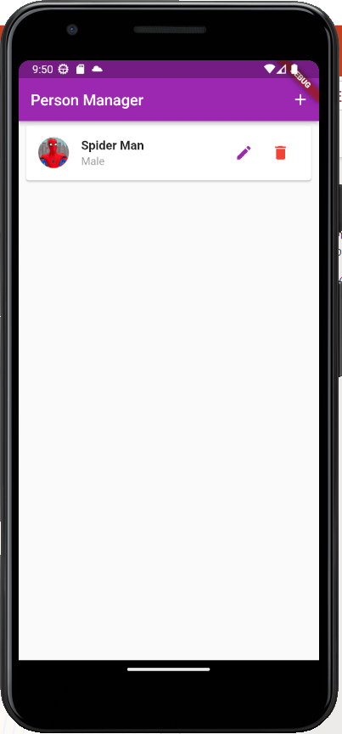
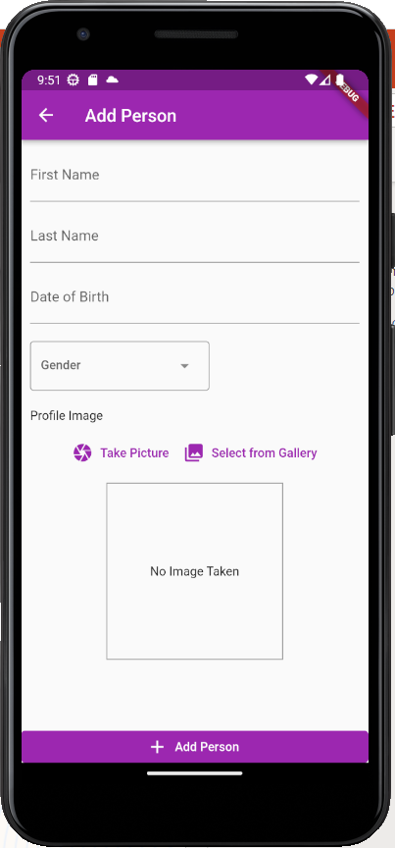
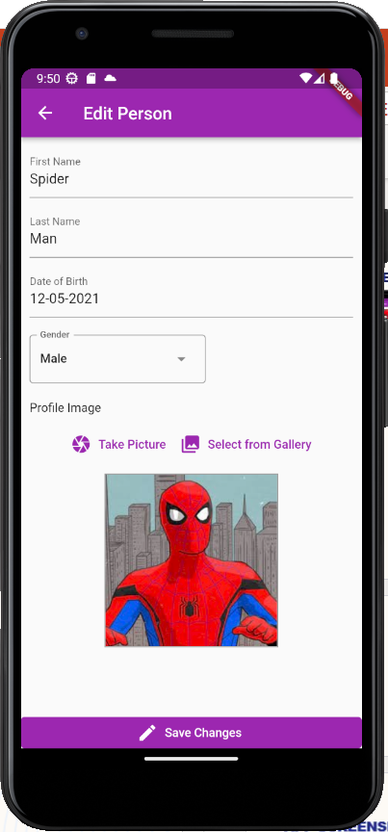
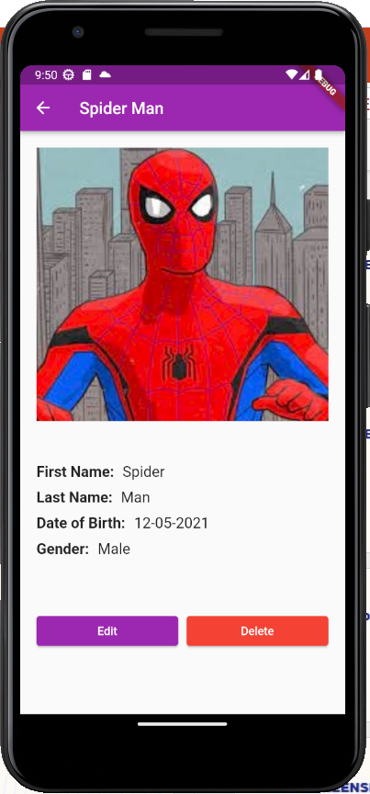
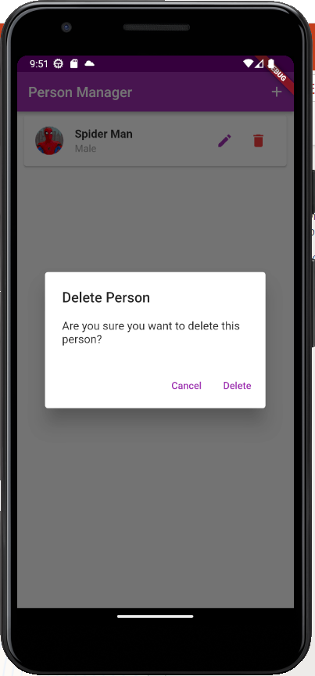
App Screenshots
List View
Create
Update
Read
Delete

Slide 9
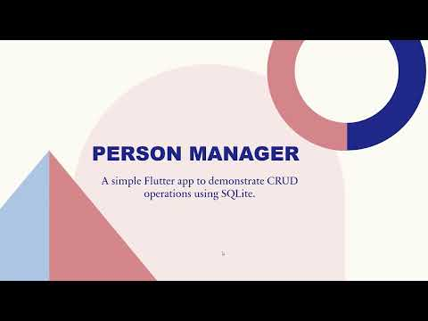
APPLICATION DEMO VIDEO
https://youtu.be/-QcufX-9E2A

Slide 10
APP SOURCE CODE

Slide 11
THANK YOU
Pavithra S
M.Tech Software Engineering
2022MT93172@wilp.bits-pilani.ac.in

